Slide 1
Municipal of Sta. Cruz Sports Committee Program and Activity Monitoring System with Online Registration
Team Members:
Erson D Mardoquio
Angelo Sam Peralta Paulino
Kendall Siclon Wrandell
Wrandell Vergel de Dios
Date: May 2025

Slide 2
Background and Initial Scope
The Sta. Cruz Sports Committee needed a digital platform to manage sports program registrations and monitor activities efficiently.
The initial system lacked robust security, making it vulnerable to common web attacks and unauthorized access.

Slide 3
Key Security Enhancements
CSRF Protection
Every form submission includes a unique CSRF token, validated on the server to prevent unauthorized or forged requests.
Password Hashing (MD5)
User passwords are hashed using the MD5 algorithm before being stored in the database, protecting user credentials from exposure.
Anti-Bruteforce Login
The system tracks failed login attempts. After 5 consecutive failures, the account is temporarily locked for 15 minutes, deterring automated attacks.

Slide 4
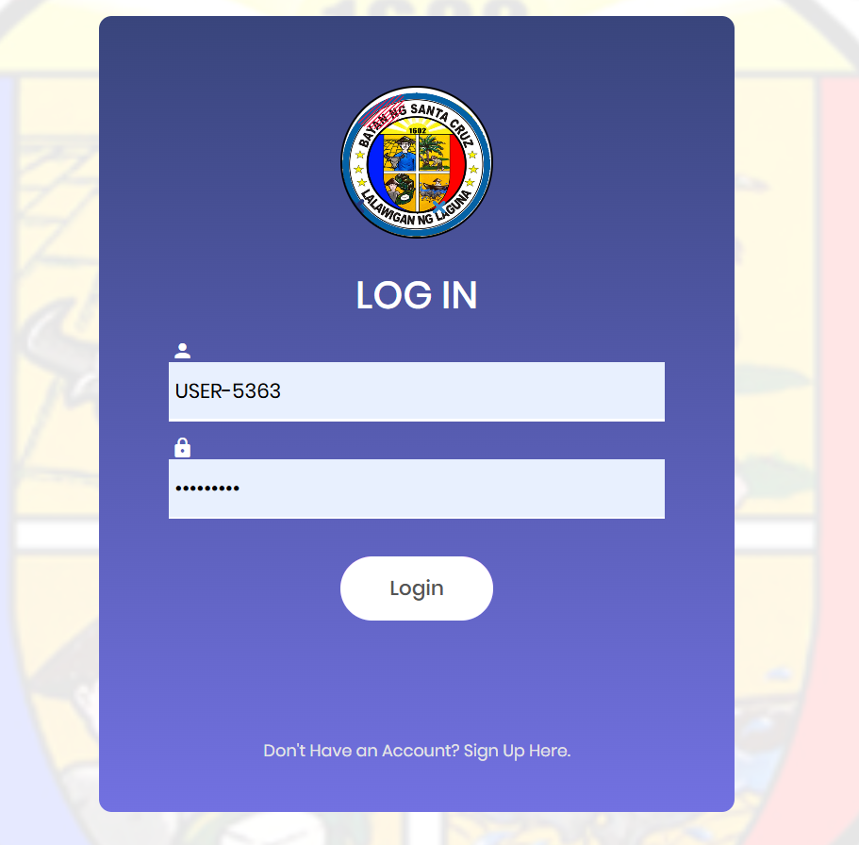
System Screenshots
Login Page
Secure login form with CSRF token embedded.

Slide 5

Registration Page:
Password input field (with backend MD5 hashing).

Slide 6
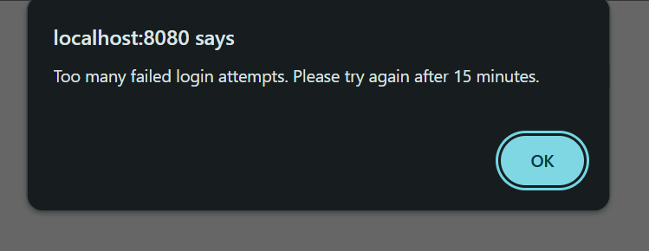
Login Attempt Notification:
Message displayed after multiple failed attempts (e.g., “Too many failed logins. Please try again in 15 minutes.”)

Slide 7
Lessons Learned
Layered Security is Critical:
Combining CSRF protection, password hashing, and anti-bruteforce measures significantly increases overall system security.
User Experience Matters:
Security features must be balanced with usability to avoid frustrating legitimate users.
Continuous Improvement:
While MD5 was used for hashing, stronger algorithms like bcrypt are recommended for future upgrades.

Slide 8
Outcomes and Benefits
Increased User Trust:
Users feel safer registering and managing their data online.
Reduced Attack Surface:
System is now more resilient to common web vulnerabilities and brute-force attacks.
Foundation for Future Enhancements:
The security framework allows for easier integration of additional features.

